Slide 1
Hospital management system
WASSAF AHMED BALOCH: 02-134222-004 M.Zain Momin: 02-134222-014 MARYAM AYUBI: 02-134222-044 Noman Arshad: 02-134222-038
BSCS-1B

Slide 2
Introduction
This Software is for the feasibility of hospital management
It maintains two level of users: Admin and visitor/patient
It includes “CRUDS” acronym which refers to the four functions that are considered necessary to implement a persistent storage application: create, read, update and delete.

Slide 3
Libraries used
#include <iostream> standard library in C++ that are used to perform input, output, and various formatting operations.
#include <string> Strings are used for storing text. A string variable contains a collection of characters surrounded by double quotes
#include <fstream> library that consists of both, ofstream and ifstream which means it can create files, write information to files, and read information from files.
#include <istream> This class is responsible for handling input stream. It provides number of function for handling chars, strings and objects such as get, getline, read, ignore, putback etc..
#include <stdlib.h>
The name "stdlib" stands for "standard library". h is the header of the general purpose standard library of C programming language which includes functions involving memory allocation, process control, conversions and others.

Slide 4
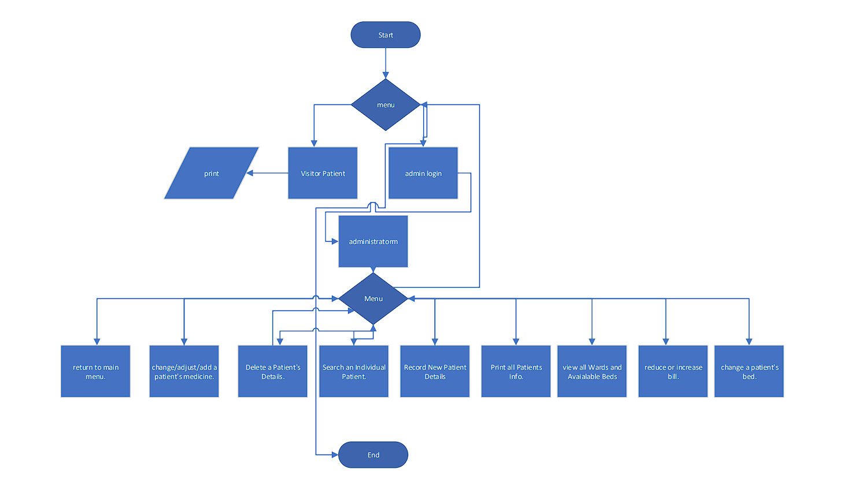
FLOWCHART

Slide 5
Functions used
int adminlogin();For administrator
void administratorm(): Main Menu after admin login
void visitor_patientm();For visitor/patient to view record
void view();To view all available wards and beds
void addp();To add patient information
void viewpatients(); To view patient's admissioned Details
int checkbed(); Check the available to beds
int searchPindex();To search specific patient
void view1patient();To view patient details
void dpd();delete patient details
void cfees();change/add/adjst patient’s bill
void cbed();change patient bed
void file();For filing (store data)
void restore();Restoring previous data in program
void cmedicine();change medicine.

Slide 6
INPUTS:
User must choose 1 out of 2 option at start
For Admin Mode user should enter 1
For patient/visitor menu user should enter 2
Admin mode will give user further options to choose in a menu
OUTPUT:
Main menu where user will choose an option
Visitor/patient option will display records ( if available)
Admin mode option will ask for correct credentials
Admin mode will further give more options such as :
Press 1 to Record New Patient Details.
Press 2 to Print all Patients Info.
Press 3 to view all Wards and Available Beds.
Press 4 to Search an Individual Patient.
Press 5 to Delete a Patient's Details.
Press 6 to reduce or increase bill.
Press 7 to change a patient's bed.
Press 8 to change/adjust/add a patient's medicine
Press 9 to return to main menu.

Slide 7
ALGORITHM
Press 1 to Record New Patient Details.
Press 2 to Print all Patients Info.
Press 3 to view all Wards and Available Beds.
Press 4 to Search an Individual Patient.
Press 5 to Delete a Patient's Details.
Press 6 to reduce or increase bill.
Press 7 to change a patient's bed.
Press 8 to change/adjust/add a patient's medicine
Press 9 to return to main menu.
Option 1 will lead user to add patient details such as ID,Name,Gender,Contact etc
Option 2 will lead user to Print all patient's information ( if available)
Option 3 will lead user to view all available wards and beds
Option 4 will lead user to search a patient and will ask user to enter Id. If found the record will be displayed.
Option 5 will lead user to delete function user will be asked to enter Id, if id is found the record will be deleted
Option 6 will lead user to billing option user will be asked to input ID of the patient if found then the user will have option to update bill. Option 7 will lead user to change bed function. It will ask user to input ward no,bed no,patient id etc
Option 8 will lead user to medicine function it will ask for Patient id, newmedicine etc
Option 9 will return user to main menu
Asks user for option 1 for admin 2 for visitor/patient 3 to close program
:Admin menu:
User must enter the correct credentials to get access.
If input is wrong user will be asked to re-enter credentials or press 0 to return to the main menu
If input is correct user will enter admin menu where he will be asked as following

Slide 8
TESTING
Testing was done by eliminating all possible combinations of choices and testing features individually. Each component of the program was tested individually to prove the functionality of the project.

Slide 9
💫Conclusion💫
The program successfully saves the patient’s data.
The program restores data
The program successfully reads, creates , deletes and updates data
The program is able to store unique id for patients
The program is user friendly
The program has decent user interface
The program displays all appropriate data.

Slide 10
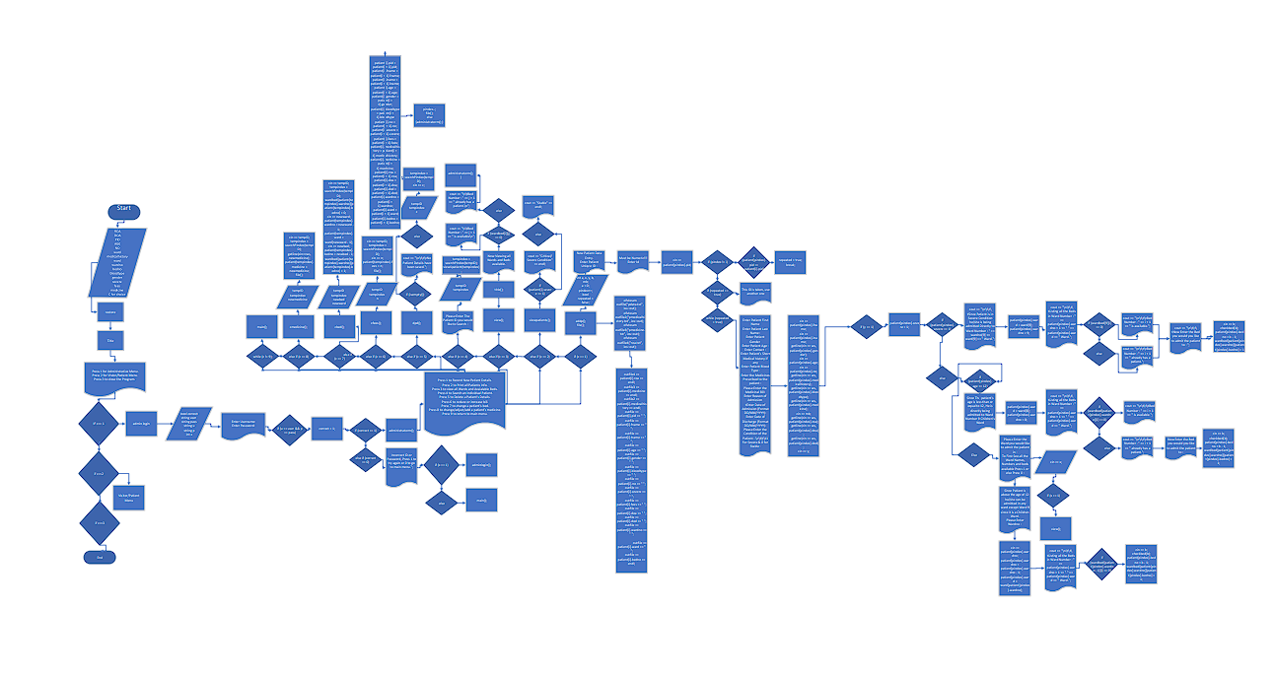
Detailed Flowchart

